Slide 1



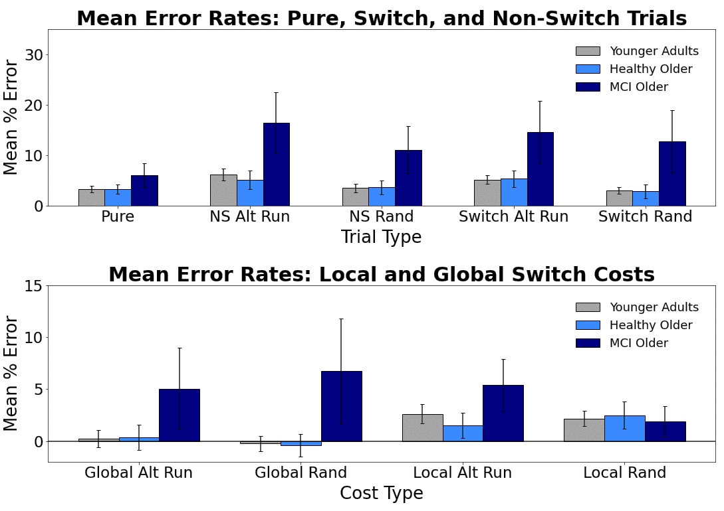
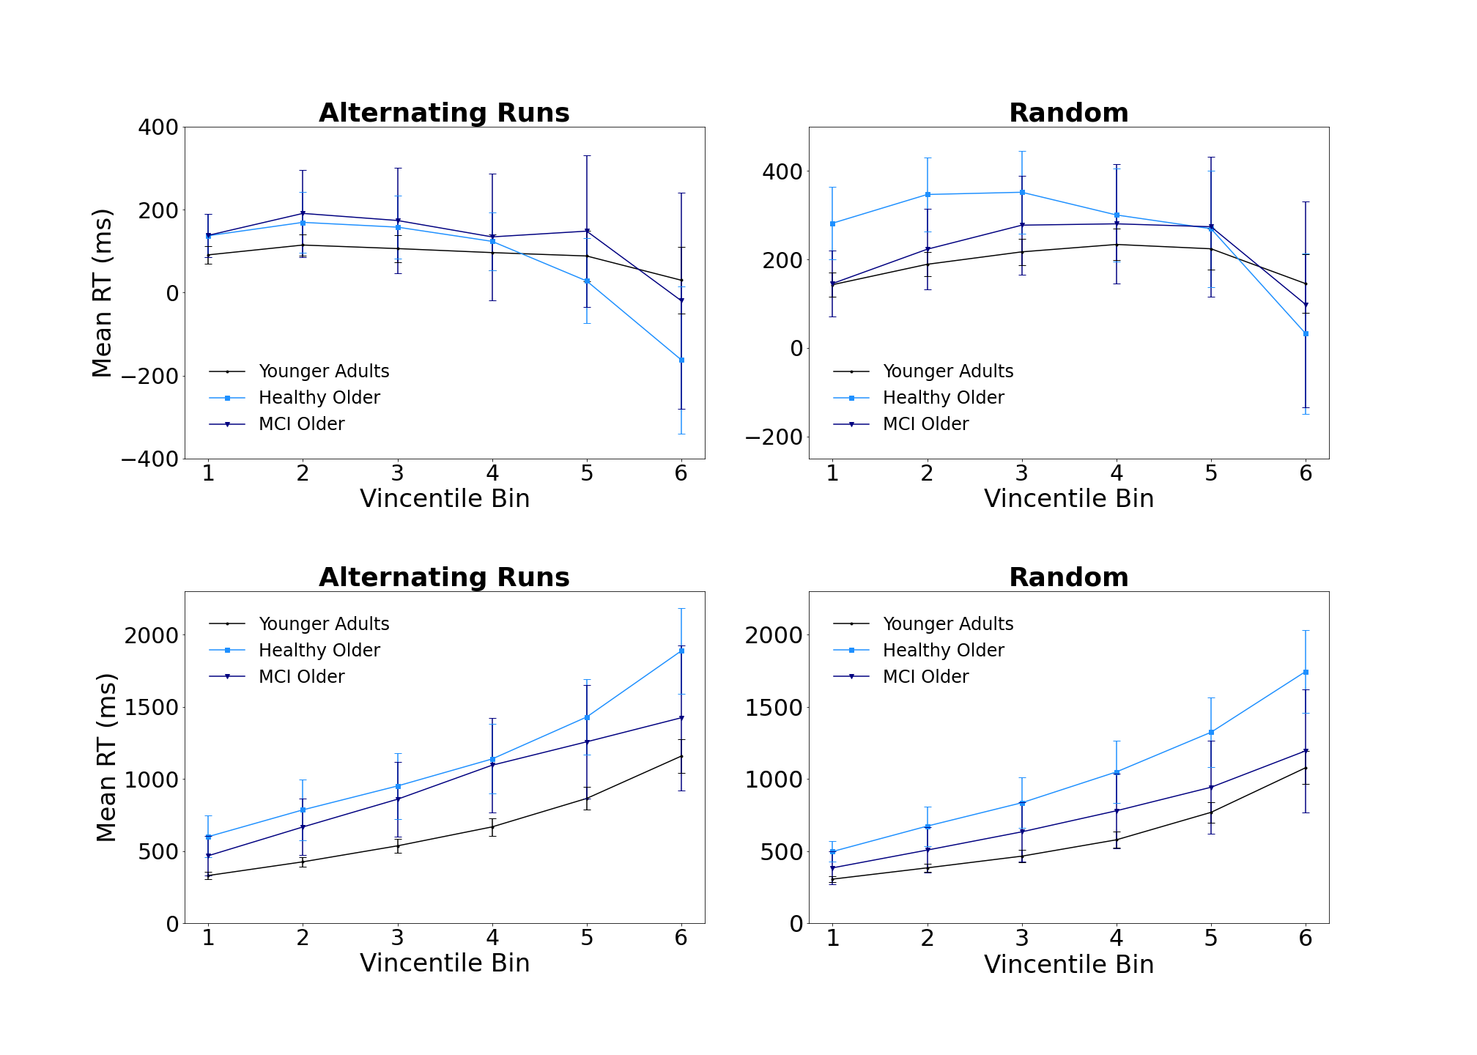
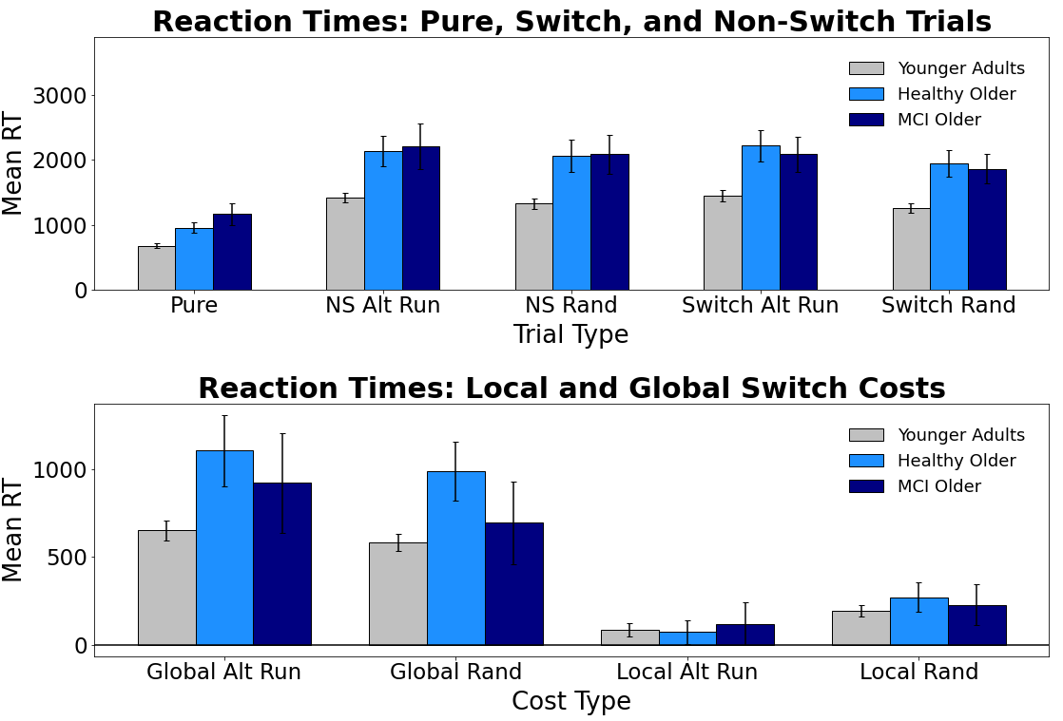
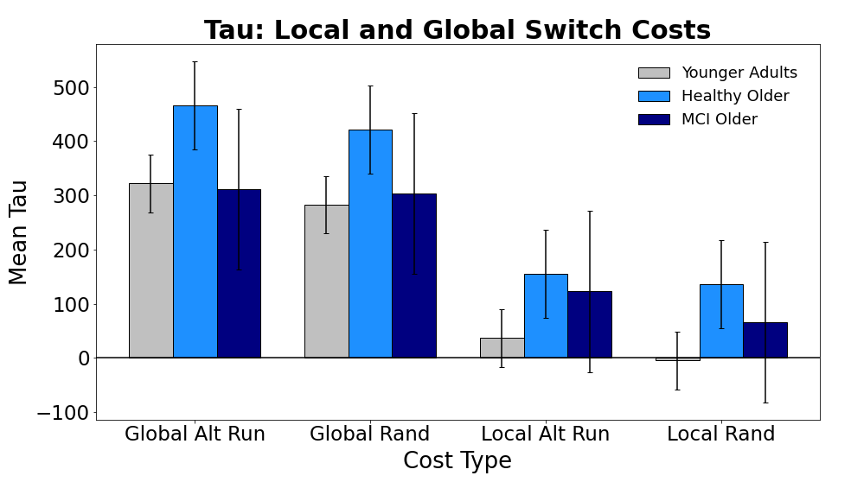
Evaluating Switch Costs using Alternating-Runs and Random Sequencing in the Consonant-Vowel/Odd-Even Task in Younger, Healthy Older, and Mildly Impaired Older Adults
Jacob M. Namias, Nicholas P. Maxwell, & Mark J. Huff
Introduction
Results: Mean Errors
Vincentile Plots
In the Consonant-Vowel/Odd-Even task (CVOE; Minear & Shah, 2008), participants view bivalent stimuli (e.g., A 08) and quickly classify the letter (Consonant/Vowel) or number (Odd/Even). Because participants complete pure blocks (i.e.., all trials are the same task) and switch blocks (i.e., switching between both classification tasks), the CVOE can be used to compare global and local switch costs. Global costs (i.e., non-switch - pure trials) denote the cost of keeping multiple task-sets active in working memory. Local costs (i.e., switch - non-switch trials) reflect task-set reconfiguration processes from switching tasks within the same block.
CVOE switch trials are often presented using a predictable, alternating-runs sequence (e.g., CV, CV, OE, OE, CV, CV). The present study compares alternating runs to random switching. We compared differences on each switch task between three groups: Younger adults, healthy older adults, and MCI older adults. In addition to assessing changes in mean errors and RTs, we assessed RT distributional differences in switch costs using Vincentile plots and ex-Gaussian parameters. We predicted greater task difficulty with random switching and this difficulty would be reflected in greater error rates and RTs versus alternating runs. Given breakdowns in working memory and control processes characteristic of cognitive impairment, we expected that MCI older adults would particularly struggle with random switching which would be reflected in greater switch costs in random switching vs. alternating runs.
Local Switch Costs
Global Switch Costs
Bars = 95% CI
Bars = 95% CI
Results: Mean RTs
Bars = 95% CI
Participants
Conclusions
Group | n | M Age | % Female | M MoCA
Younger Adults | 89 | 19.67 | 66% | 28.36
Healthy Older | 33 | 73.92 | 75% | 27.75
MCI Older | 26 | 75.88 | 41% | 24.00
Overall, MCI older adults produced more errors vs. younger and healthy older adults. Both older adult groups had slower RTs comparted to younger adults across trial types. However, within each group, few differences were found between alternating runs and random switching regarding errors and RTs. Regarding switch costs, global error costs did not differ between switch types across groups. For local error costs, MCI older adult switch costs were greater for alternating runs than random switching. Finally, for mean RT switch costs, global costs did not differ as function of switch pattern. However, younger and healthy older adults showed greater local RT costs when switching was random, suggesting that the random switch task was more taxing towards task-set reconfiguration processes. This pattern did not extend to MCI older adults, suggesting that they were not well tuned to the switch task.
Next, vincentile plots showed that, across groups, local costs decreased across bins, while global costs increased. However, no differences occurred between local or global costs for predictive and non-predictive switching. Fitting RTs to an ex-gaussian distribution showed that tau (i.e., positive tail of the RT distribution) was greater for global costs vs. local costs. Furthermore, tau was higher for healthy older adults relative to younger adults. However, like the vincentile plots, tau did not differ as function of switch pattern. Thus, while relative to younger adults, both older adult groups show increased RTs and MCI older adults commit more errors, these differences are not further increased when switching is random. Instead, it appears that simply having individuals engage in predictive task-switching is sufficient to produce errors and slow responding, and that these declines in performance primarily increase as a function of age/health rather than switch-task difficulty.
Materials
Letters: A, D, E, H, I, J, I, P, S, U
Numbers: 1-99
Bars = 95% CI
Pair
D 15
A 04
E 23
H 36
Task
CV
CV
OE
OE
Correct Response
C
V
O
E
Ex-Gaussian Analysis
General Method
Pure Trials
(2 Blocks)
Switch Blocks
(2 Blocks)
MoCA
Note: Participants completed four blocks (CV, OE, Alt Runs, and Random). The first two blocks always contained pure trials (CV or OE). The final two blocks were always switch blocks (Alt Runs or Random). MoCA = Montreal Cognitive Assessment
Bars = 95% CI
Correspondence regarding this project can be addressed to jacob.namias@usm.edu.
More info available at: www.macapsych.com | https://osf.io/yrdsz/

